Slide 1


PayPause
A breath before it’s gone.
Banking app proposal
Pause unusual payment activity before it becomes a regret.
Presented by: Sai Charan Beemara
Client : Dr. Victor Govindaswamy
Project Proposal • 2026

Slide 2

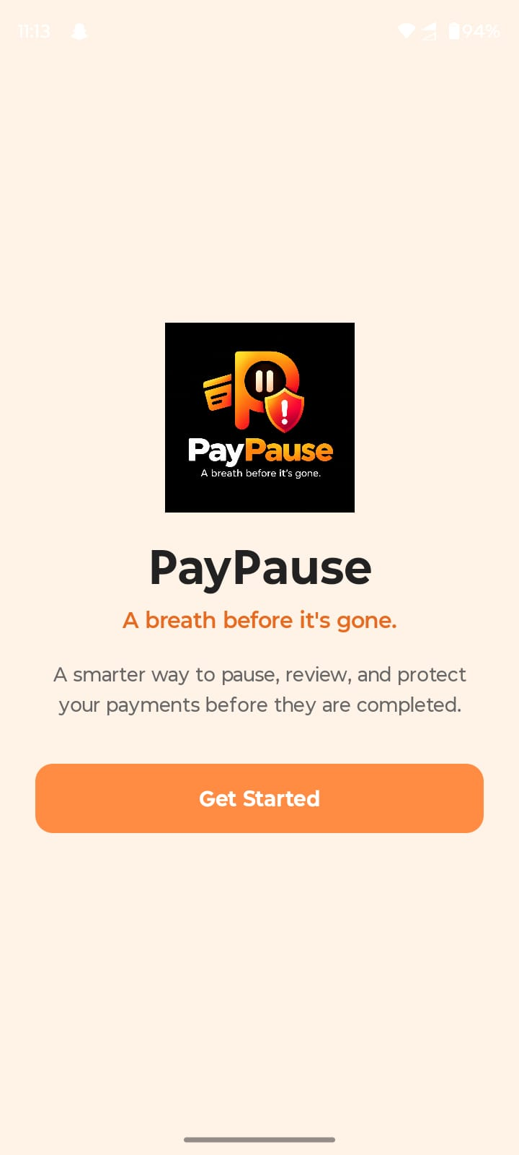
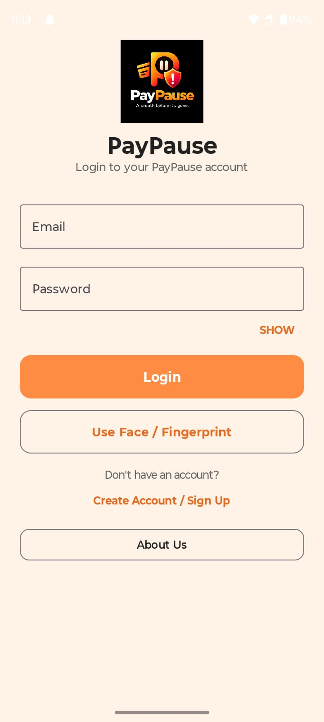
Current UI: Welcome and About
Show the entry point and the product information available to the user.
Welcome
About PayPause
PayPause • A breath before it’s gone.
Notes:
Explain how the user starts and how the About screen describes the product. Clarify whether these are design screens or running app screens.

Slide 3
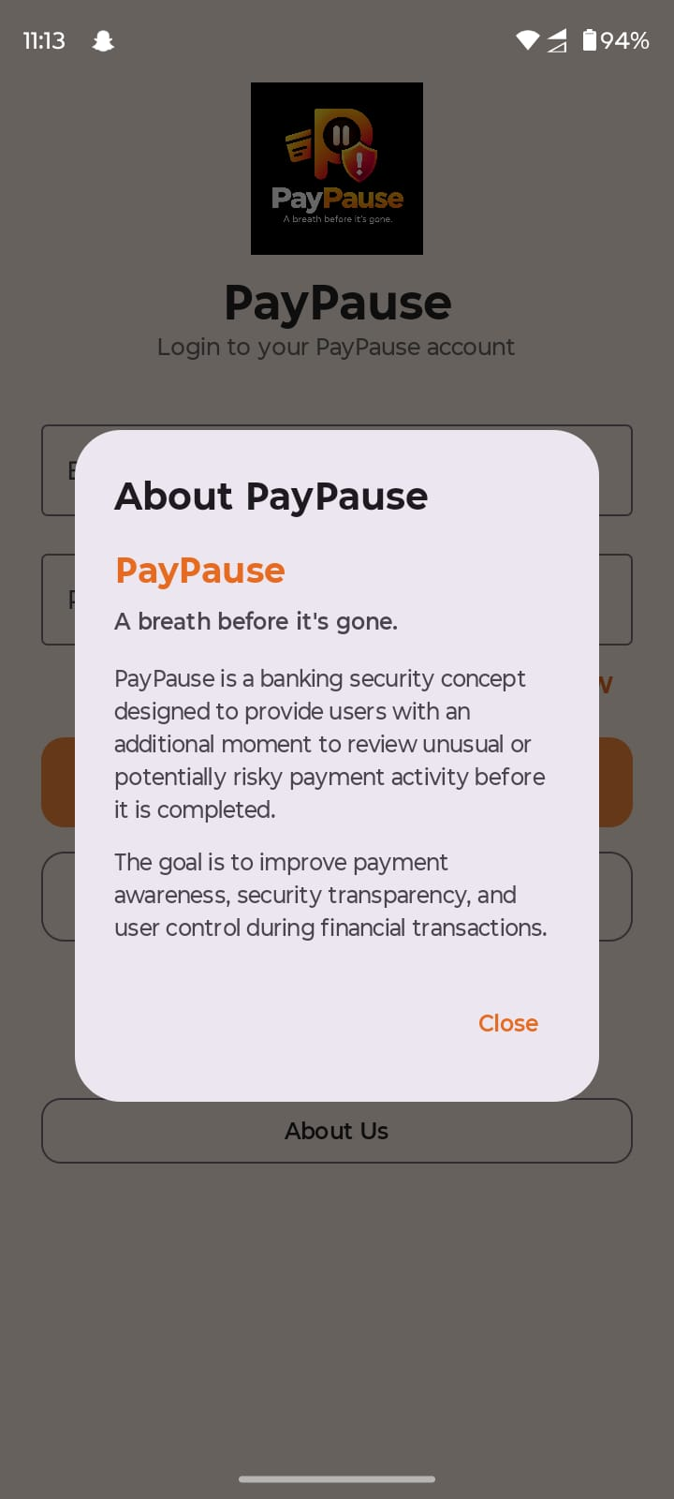
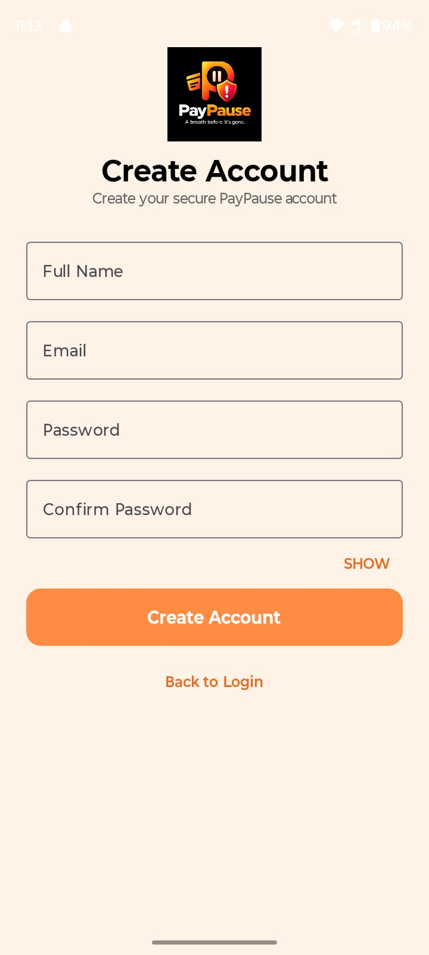
Current UI: account access
The materials show email login, biometric login and account creation.
Log In
Create Account
PayPause • A breath before it’s gone.
Notes:
Demonstrate account creation, password validation, email login and biometric login only if those paths work in the current application.

Slide 4
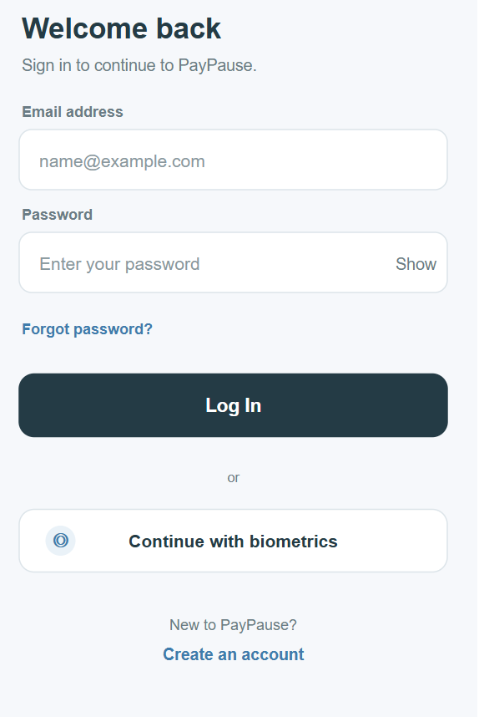
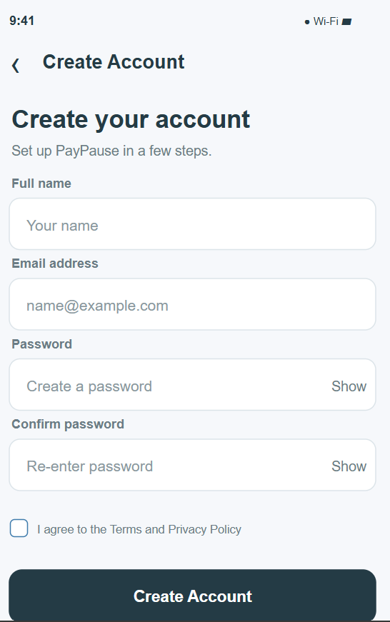
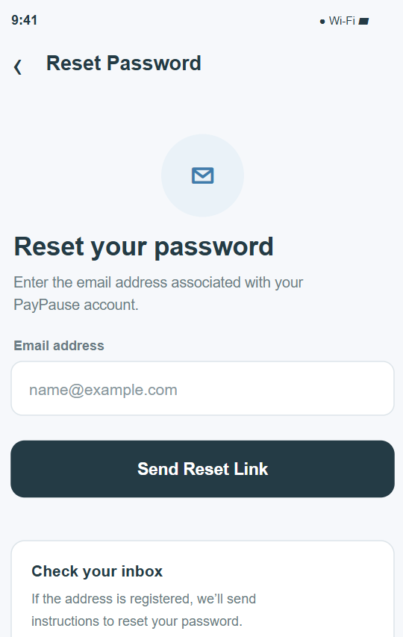
GUI Wireframes
PayPause • A breath before it’s gone.
Notes:
Demonstrate account creation, password validation, email login and biometric login only if those paths work in the current application.

Slide 5
Feature Comparison — Where PayPause Is Different
Security capability/ Apps
Chase
Venmo
BofA
PayPause
What it adds
✓
✓
✓
✓
Biometric / strong sign-in
Completed
✓
✓
✓
✓
Fraud / transaction monitoring
Completed
✓
✓
✓
✓
Security alerts
In Progress
x
x
x
✓
Continuous behavior signals
In Progress
x
x
x
✓
Live session-risk visibility
In Progress
x
x
✓
✓
Screen Recording stopped
In Progress
x
x
x
✓
Pause before unusual payment
Completed

Slide 6
Background application reviews
These detailed reviews belong to the proposal phase and remain part of the project evidence.
For each required existing application, be ready to show:
Proposal review | Evidence in proposal deck | Relevant observation carried into Sprint 1
Chase Mobile | App profile + feature comparison | Strong sign-in, monitoring and alerts marked present; no pause-before-payment feature marked
Venmo | App profile + feature comparison | Strong sign-in, monitoring and alerts marked present; no pause-before-payment feature marked
Bank of America | App profile + feature comparison | Strong sign-in, monitoring and alerts marked present; screen recording marked present in proposal chart
The next slides preserve the proposal feedback, detailed app reviews and original comparison chart as supporting evidence.
PayPause • A breath before it’s gone.
Notes:
The application names and comparison observations summarize the proposal deck supplied by the PM. Original proposal slides follow for detailed review.

Slide 7
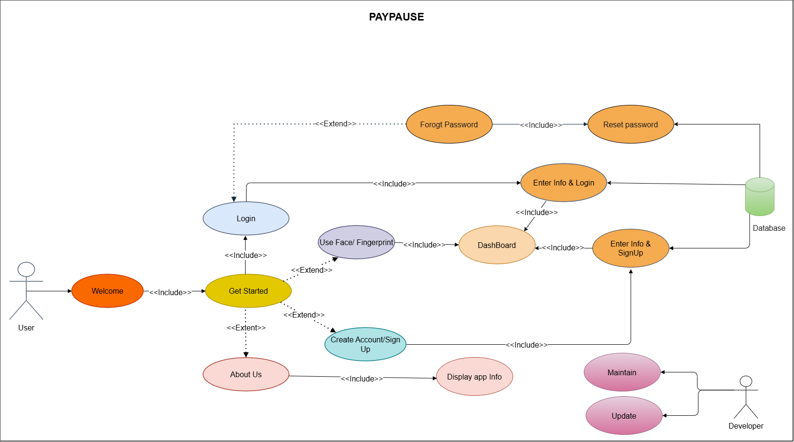
Use Case Diagram
PayPause • A breath before it’s gone.
Notes:
Explain the actor and the user goals shown. Connect each major use case to the actual screen and demo.

Slide 8
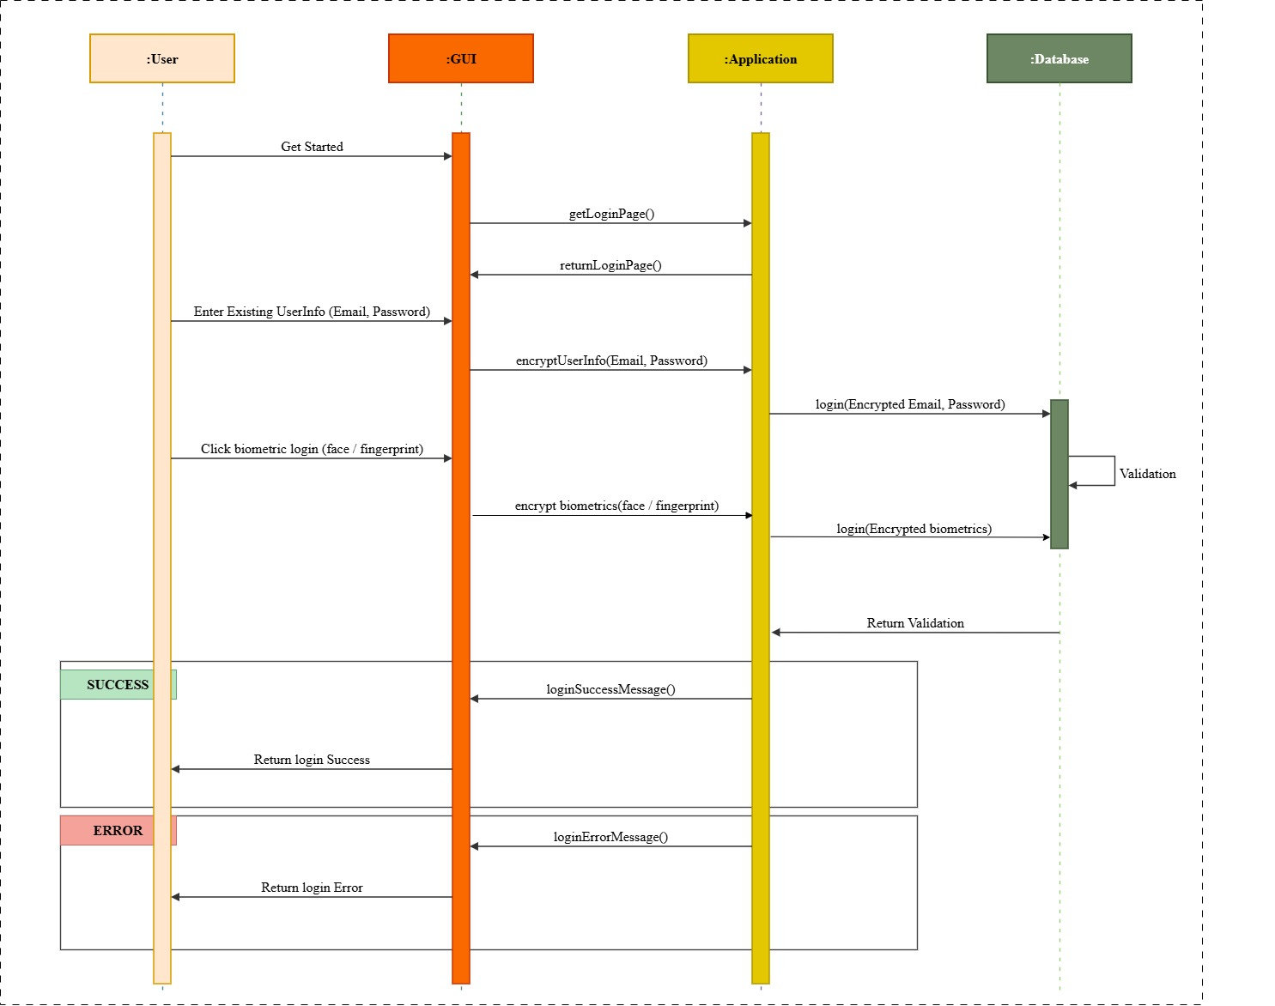
Login Sequence Diagram
PayPause • A breath before it’s gone.
Notes:
Walk through form entry, validation, account creation, success and retry paths. Point out any backend work that remains planned.

Slide 9
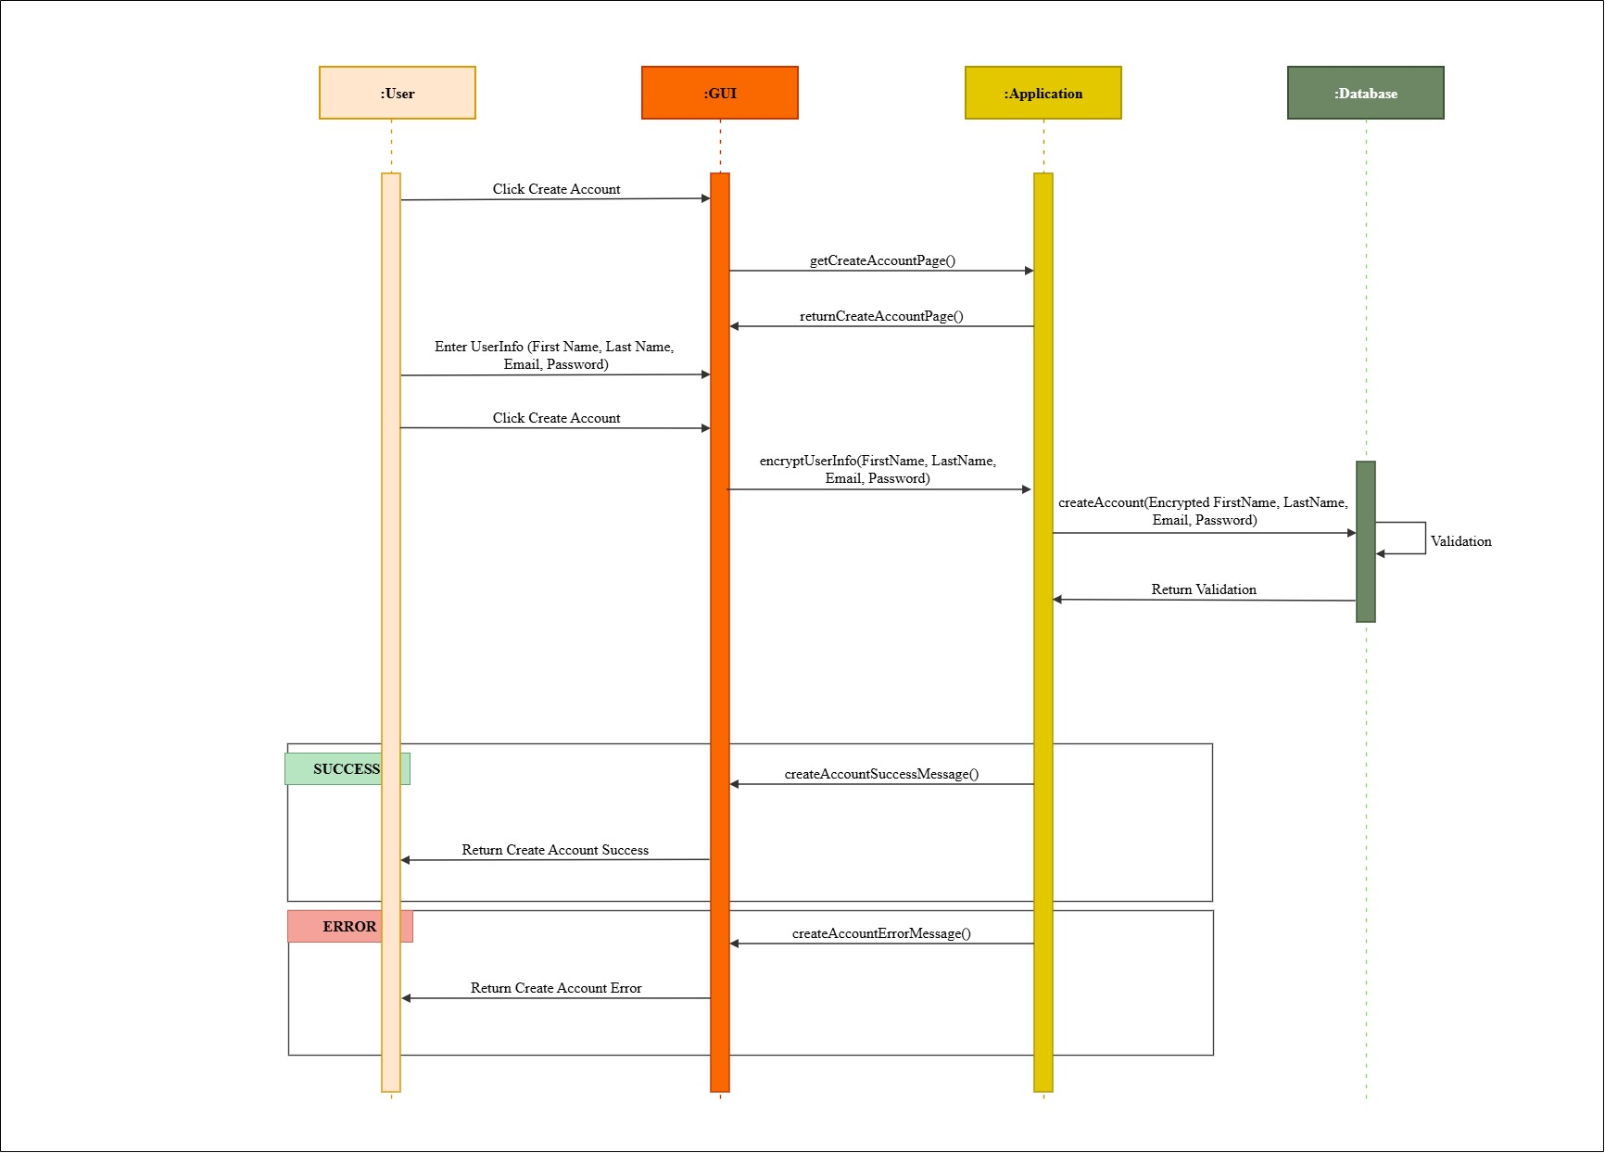
Create Account Sequence Diagram
PayPause • A breath before it’s gone.
Notes:
Explain the reset link flow and show the current behavior in the app. Use a generic response so the interface does not disclose whether an account exists.

Slide 10
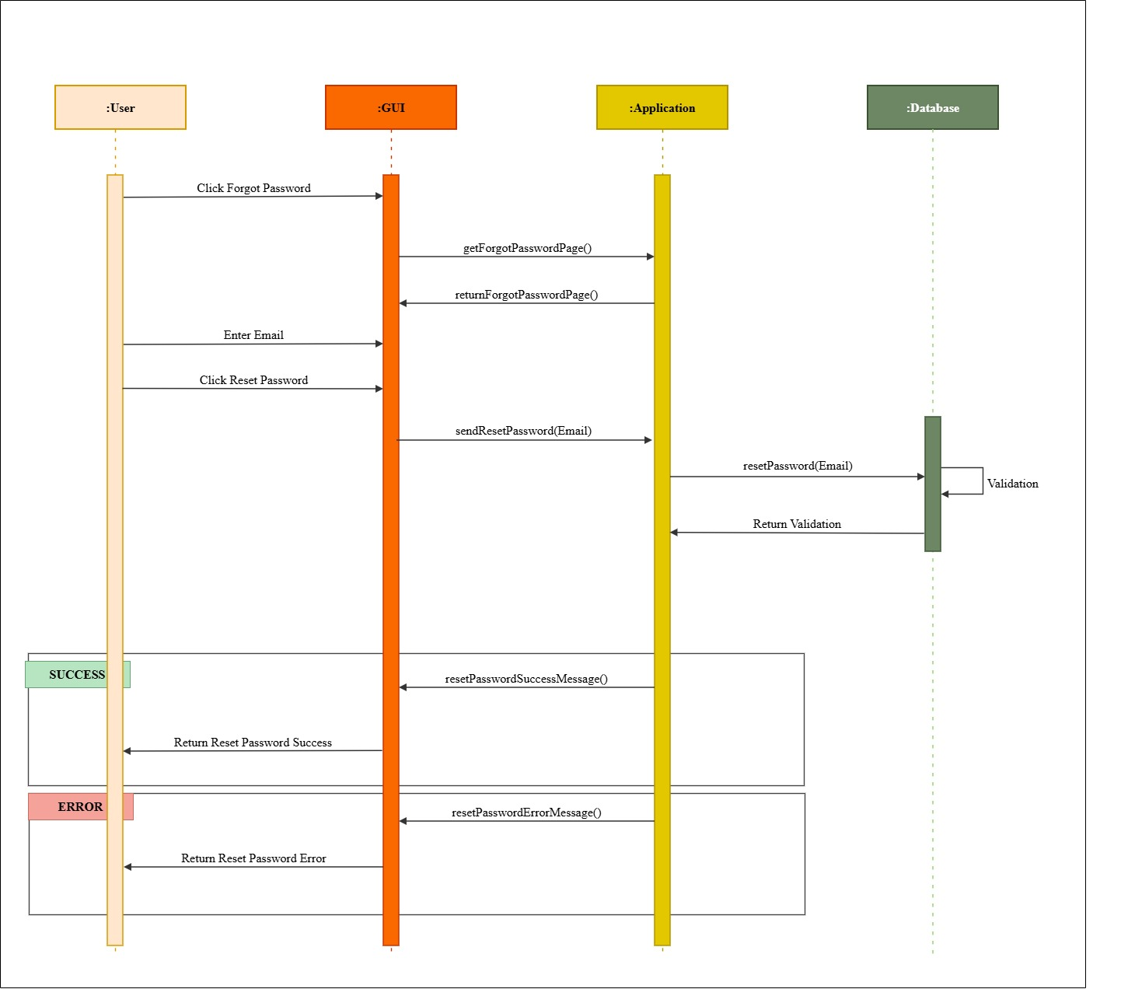
Forgot Password Sequence Diagram
PayPause • A breath before it’s gone.
Notes:
Explain the reset link flow and show the current behavior in the app. Use a generic response so the interface does not disclose whether an account exists.

Slide 11
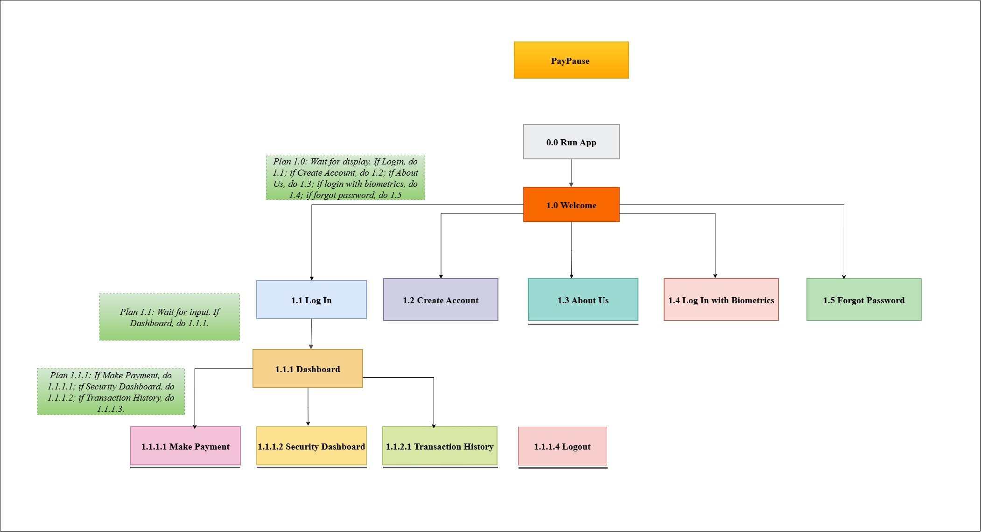
Hierarchical Task Analysis
PayPause • A breath before it’s gone.
Notes:
Explain how the task breakdown supports the sequence of screens and features in the current increment.

Slide 12
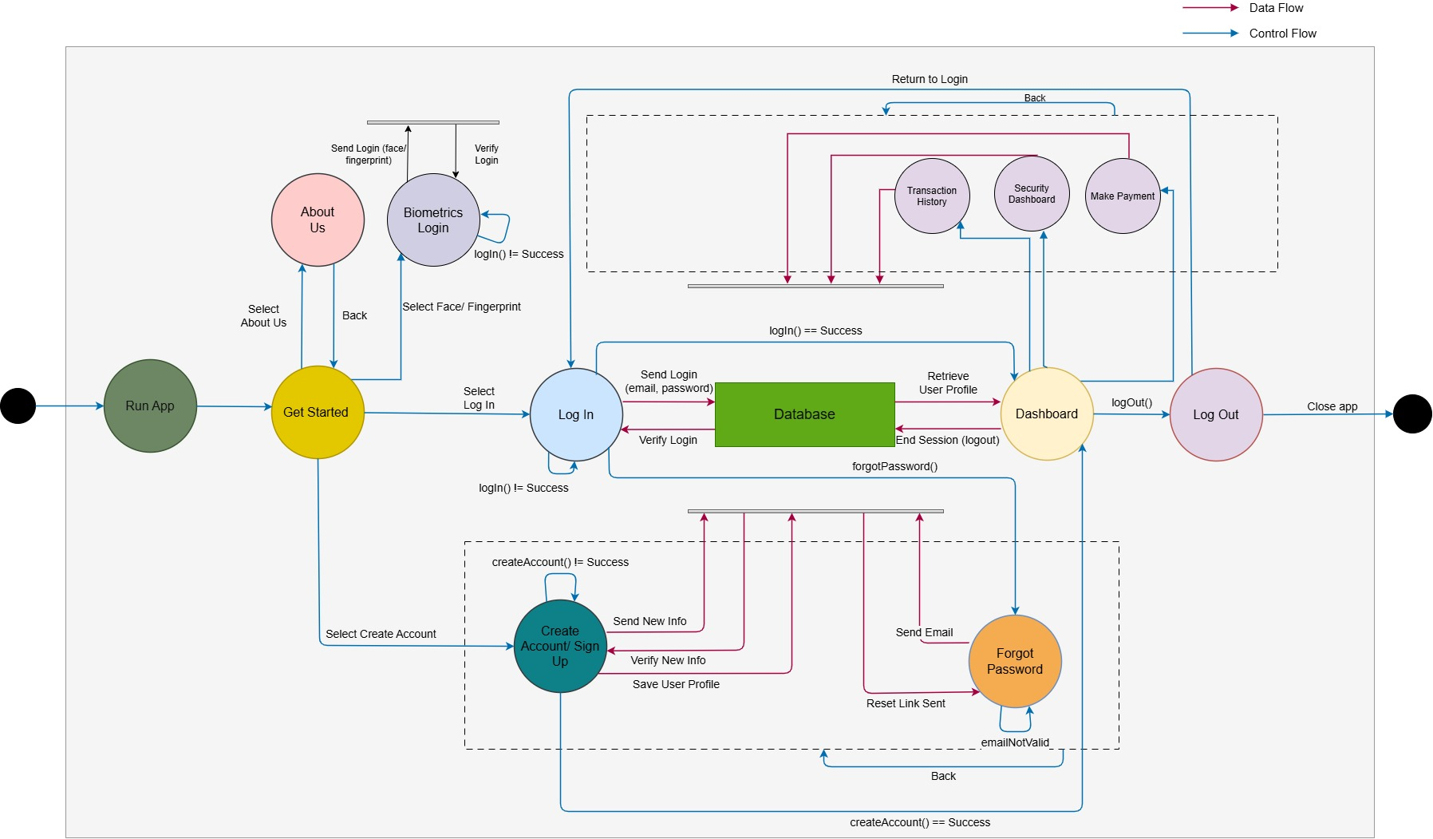
Data Flow & Control Flow Diagram
PayPause • A breath before it’s gone.
Notes:
This is a logical Sprint 1 view. Point out that the dashed data-store paths describe planned integration, while the current demo should show only what is actually implemented.

Slide 13
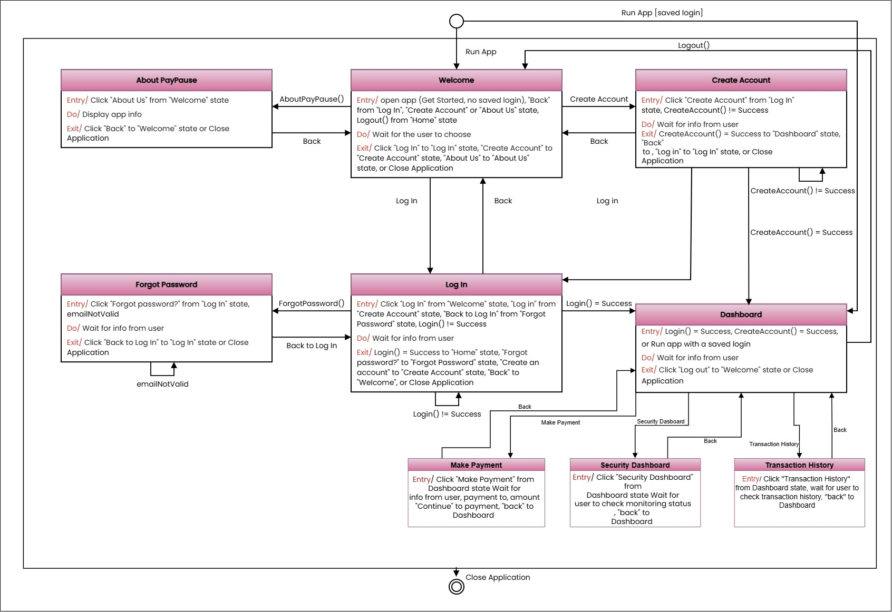
Finite State Diagram- Level 0
PayPause • A breath before it’s gone.
Notes:
Explain entry, active state and exit transitions. Compare the state flow to the live app and note any changes from customer feedback.

Slide 14
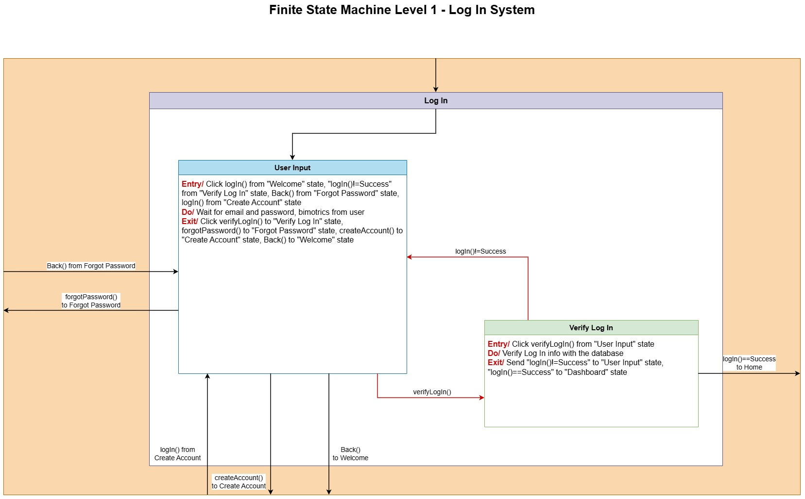
Finite State Diagram- Login Level 1
PayPause • A breath before it’s gone.
Notes:
Explain entry, active state and exit transitions. Compare the state flow to the live app and note any changes from customer feedback.

Slide 15
Testing evidence
Test | Expected result | Actual result | Outcome / defect
Valid account creation | Account flow completes with accepted details | Record live result | Pass
Invalid account input | Clear validation; no invalid submission | Record live result | Pass
Login / biometric path | Correct success or retry response | Record live result | Pass
Hide / show balance | Balance visibility changes as expected | Record live result | Pass
Payment review / cancel | Review shown; cancel returns safely | Record live result | Pass
Reset password | User receives reset guidance / completes flow | Record live result | Pass
PayPause • A breath before it’s gone.
Notes:
Run the tests on the current build. Enter observed results before presenting; these rows are test prompts, not claims that tests have passed.

